Slide 1
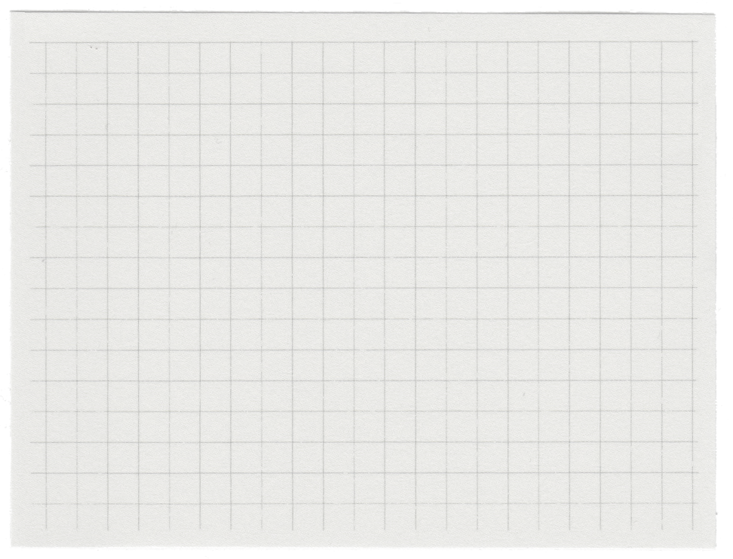






Project Poster
on
Farming Web Assistance Services
Presented By
Aviral Jaiswal(2101220100035)
Himanshu Singh Chauhan(2101220100054)
Under the Guidance of
Er. Abhishek Dubey
SHRI RAMSWAROOP COLLEGE OF ENGINEERING & MANAGEMENT LUCKNOW
Affiliated to
DR. APJ ABDUL KALAM TECHNICAL UNIVERSITY , LUCKNOW

Slide 2





Introduction
India’s agriculture supports 55% of its population but faces issues like middlemen, poor storage, and lack of market access. The Farming Assistance Web App connects farmers directly with suppliers, provides real-time market data, optimizes resource use, and supports community interaction. It’s mobile-friendly, secure, and designed to make farming more efficient, sustainable, and profitable.

Slide 3

Problem Definition
Lack of sound marketing facilities forces farmers to depend on local traders and middlemen to sell their produce at very low prices.
Inadequate or no storage facilities in rural areas compel farmers to sell their crops immediately after harvest, often at unfavorable prices.
These conditions lead to distress sales, depriving farmers of their rightful income.

Slide 4

Project Objectives
The objective of the Farming Assistance Web Application is to create a digital platform that bridges the gap between farmers and suppliers, eliminating the need for middlemen. It aims to provide farmers with real-time market prices, crop demand information, and a system to raise complaints for prompt resolution. Additionally, the platform supports efficient resource management and encourages community interaction among farmers and experts, ultimately improving agricultural productivity, profitability, and sustainability.

Slide 5



Proposed Methodology
Here's a concise overview of how the Iterative Waterfall model applies to the Farming Web Assisting Services project:
•Requirements Analysis:
Gather and refine user requirements through iterative feedback.
•System Design:
Create a solid design, tested and refined in iterations.
•Implementation:
Develop features in phases, adjusting based on continuous feedback.
•Testing:
Test early and throughout development, refining as needed.
•Deployment:
Deploy the system, then refine with incremental updates.
•Maintenance:
Continuously improve the system with regular updates based on evolving needs.

Slide 6

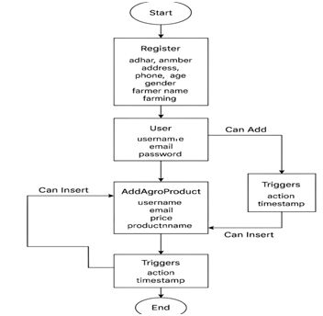
FLOW CHART

Slide 7
System Overview
The Farming Assistance Web Application is a digital platform that connects farmers directly with suppliers, offers crop demand ads, allows complaint submissions, and provides real-time market data. It includes tools for resource management and is mobile-friendly, secure, and easy to use—helping farmers improve productivity and income.

Slide 8


Technollogies Used
HTML (HyperText Markup Language):
Used to structure the content and layout of web pages. It defines elements like headings, paragraphs, tables, and forms.
CSS (Cascading Style Sheets):
Enhances the visual appearance of HTML elements. It controls layout, colors, fonts, and responsiveness across devices.
JavaScript:
Adds interactivity to the website such as form validation, dynamic content updates, and real-time interactions. It runs on the client side to enhance user experience.
PHP (Hypertext Preprocessor):
A server-side scripting language used to handle backend logic. It processes user requests, handles form data, and communicates with the database.
MySQL:
A relational database management system used to store and manage data. It handles user information, crop listings, complaints, and market data efficiently.
Apache Web Server:
Hosts the web application and serves web pages to users. It handles HTTP requests and manages the communication between the server and client.

Slide 9

Advantages
Connects farmers directly with suppliers, removing middlemen.
Provides real-time market prices and crop demand.
Allows complaint registration and admin resolution.
Offers tools for resource (water/fertilizer) management.
Mobile-friendly and easy to access from anywhere.
Ensures data privacy and secure transactions.
Encourages community support and expert guidance.
Increases productivity, income, and sustainability.

Slide 10
Limitations
Internet Dependency: Requires a stable internet connection, which may not be available in all rural areas.
Digital Literacy: Some farmers may lack the skills to use web-based platforms effectively.
Initial Adoption Resistance: Traditional farmers may be hesitant to adopt new technology.
Language Barrier: If not available in local languages, usability may be limited.
Limited Reach: May not cover all regions or crop types initially.
Maintenance Required: Regular updates and server maintenance are necessary for smooth functioning.
Data Accuracy: Relies on accurate and timely data inputs for market prices and trends.

Slide 11
Reall-Worlld Appllications
Direct selling of crops to suppliers
Real-time crop price updates
Crop planning based on market demand
Complaint registration and support
Efficient use of water and fertilizers
Farmer-to-farmer and expert networking
Mobile access for rural users
Data-based farming decisions

Slide 12
FUTURE SCOPE AND IMPLEMENTATION
IoT Integration: Incorporate smart sensors to monitor soil moisture, weather, and crop health in real-time.
AI-Powered Predictions: Implement AI models to predict crop yields, pest outbreaks, and optimal farming practices.
Mobile Application: Develop a mobile app for farmers to access services on the go.
E-commerce Platform: Enable farmers to purchase farming supplies directly from the platform.
Farmer Community: Create forums and chat features for farmers to share knowledge and collaborate.
Sustainability Focus: Provide guidance on sustainable and organic farming practices, promoting eco-friendly techniques.

Slide 13



Project Demonstration!

Slide 14
Thank you very much!

